Slide 1
ENHANCING MODEL EXPLAINABILITY FOR CLUSTERING & DEEP LEARNING ALGORITHMS IN CUSTOMER SEGMENTATION IN BANKING

Slide 2

INTRODUCTION
Problem statement
Proposed solution
Methodology
MODEL IMPLENTATION
Key findings
Result Analysis
conclusion
overview

Slide 3
Introduction
PREAMBLE
​Banks offer a variety of services such as loans, accounts, and investments, which are crucial for fostering economic growth. They have a wide range of customers with different financial requirements.
Customer segmentation is crucial for banks as it enables them to customize products and services to certain customer groups according to their behaviours and demands.
By enhancing model explainability, banks can not only comply with legal standards but also gain strategic advantages through increased customer trust and satisfaction.
BACKGROUND
Banks have progressed from using basic criteria like age and income to complex behaviours for customer segmentation, driven by big data and machine learning advancements.
Machine learning and deep learning technologies analyse large datasets to reveal patterns, predict customer behaviour, and automate decisions, improving the precision and efficiency of customer segmentation.
The need for XAI in banking is driven by the sector's focus on customer segmentation—dividing customers into specific groups based on various attributes and behaviours.

Slide 4


PROBLEM STATEMENT
Existing issue
Banks that employ old methods of segmentation fail to capture 30-50% of potential revenue from targeted marketing.
Traditional consumer segmentation techniques often use broad rules of thumb, resulting in vague divisions that do not reflect customers' evolving behaviours.
A startling 85% of AI projects inside companies fail to meet their goals, primarily due to a lack of transparency and trust.
Current reality
Banks spend approximately £18bn annually on marketing, yet much of this is lost due to poorly targeted campaigns.
Although clustering and deep learning methods demonstrate potential in research, they are still not widely used in real-world banking.
Barriers in technology, operations, and strategy make it difficult for banks to move from proof-of-concept studies to scalable, real-world implementations.

Slide 5
Proposed solution
The development of clustering and deep learning models that can analyse large and complex customer segmentation datasets, which can consider numerous features simultaneously and identify intricate patterns accurately. Integrate techniques such as Local Interpretable Model-Agnostic Explanations (LIME) and other XAI methods to make complex clustering models more interpretable.
Benefits
Better segmentation and personalized services result in improved customer experiences and loyalty.
XAI techniques enhance model explainability, fostering trust and meeting regulatory requirements
Scalable and practical solutions ensure smooth integration into existing banking operations, enabling sustainable long-term benefits.

Slide 6
methodology
Bank Credit Customer Data
Pre-Processing
Model Evaluation
Application of XAI
Training
Model Development
The Bank Credit Customer Segmentation dataset was obtained from Kaggle, it contains features pertinent to customer transactional details.
This involves converting raw data into a structured and applicable format.
The development process involves the strategic design and construction of algorithms tailored to enhance customer segmentation accuracy and effectiveness.
During the training process, the model learns about patterns. The dataset includes both input and expected outcome.
It measures the performance of the machine learning models.
This approach is pivotal for understanding the factors driving the segmentation and ensuring the transparency of the predictive process.

Slide 7
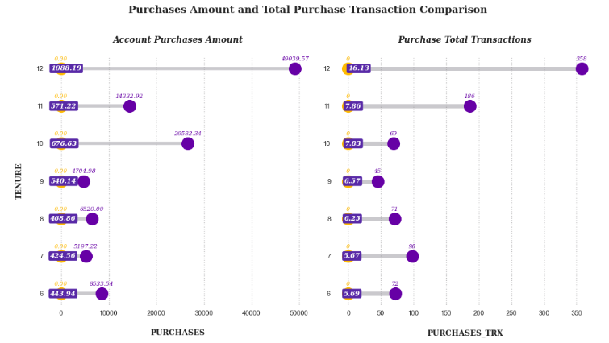
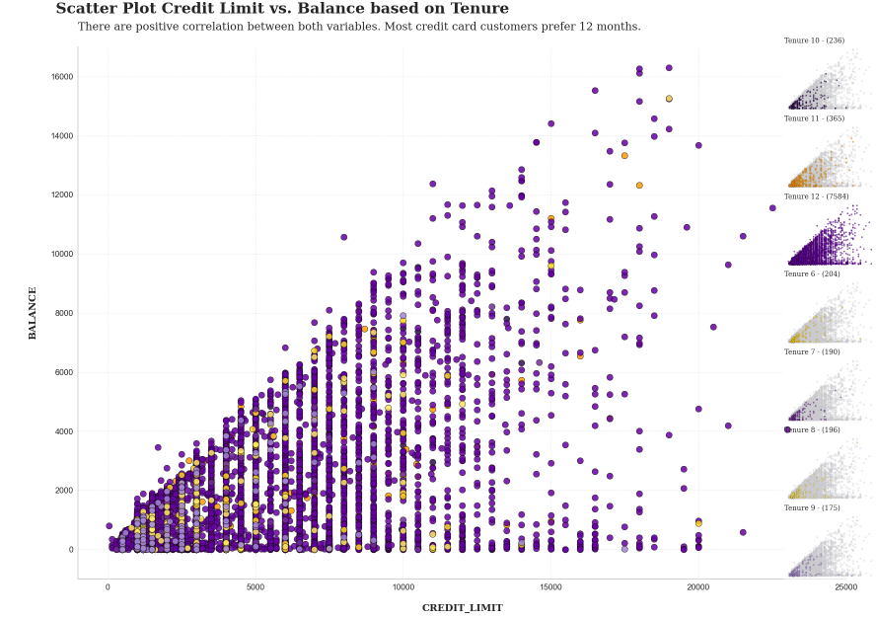
Key findings
Credit card users who have been with the bank for 12 months are more inclined to make larger purchases amounts and have a higher number of total transactions compared to customers with different tenure.
As the credit limit rises, the balance tends to increase accordingly, indicating a linear correlation.
This practice is related to how clients extend debt payments to earn more interest. Some clients avoid transactions to increase their credit limit, which boosts their credit scores and utilisation ratios.

Slide 8
MODEL IMPLEMENTATION
KMeans | Hierarchical Clustering | Gaussian Mixture | DBSCAN | Deep Belief Network
Used to group data points into k distinct clusters based on their similarity or distance from cluster centroids. | Used for identifying nested clusters and understanding hierarchical relationships | It assumes data points are from multiple Gaussian distributions with unknown parameters. | Finding arbitrarily shaped clusters and identifying noise in the data. | Feature learning, dimensionality reduction, and pre-training of deep neural networks.
Assigns data points to nearest cluster centre and iteratively updates centres. | Builds a hierarchy of clusters using agglomerative or divisive methods | It provides a soft-clustering mechanism, assigning a probability to each point to belong to a certain cluster. The optimal cluster number is determined by the Bayesian and Akaike Information Criterion. | Groups closely packed points and identifies noise based on epsilon (distance threshold) and minPoints (minimum points to form a cluster). | Consists of multiple layers of stochastic latent variables, trained layer-wise.
Simplicity and efficiency | Simple to interpret | Medium efficiency and adaptability | Efficient | High adaptability

Slide 9
RESULT ANALYSIS
Algorithm | Davies-Bouldin Index | Silhouette Score | Calinski Harabasz Index
K-means Clustering | 1.27 | 0.331 | 3840.79
Hierarchical Clustering (Agglomerative) | 1.508 | 0.294 | 3471.378
DBSCAN | 1.646 | 0.028 | 25.717
Gaussian Mixture Model | 2.995 | 0.172 | 1586.081
Deep Belief Networks (DBN) | 1.959 | 0.195 | 3138.670

Slide 10
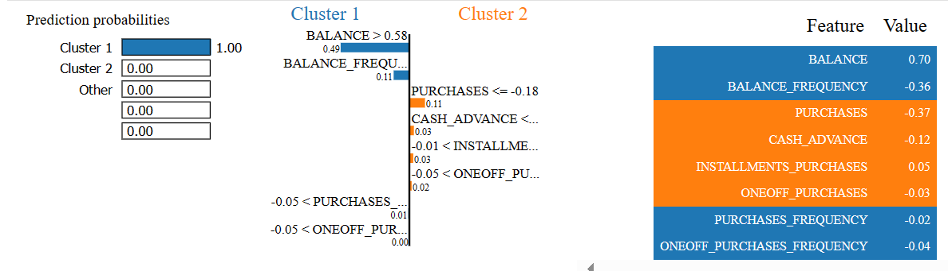
XAI RESULT ANALYSIS
LIME PERFORMANCE ANALYSIS
FINDINGS
Here, the model predicts the customer's cluster based on features such as balance, purchase frequency, and cash advance amount etc.
Each feature's impact is quantified in the LIME output, displaying positive or negative influences. For example, a higher balance (BALANCE > 0.58) contributes positively to being in Cluster 1, while lower purchase frequencies contribute negatively, highlighting the diverse factors that affect customer segmentation.

Slide 11

conclusion
K-Means Clustering emerged as the most effective technique for this dataset, achieving the best balance between cluster cohesion and separation. It was assessed based on Davies-Bouldin Index, Silhouette Score, and Calinski Harabasz Index.
The model explained the customer base structure and identified transaction behaviour and financial characteristics-based customer groups.
Transparent customer segmentation using LIME and PCA provides localized feature attribution and a principal component view of influential features, clearly explaining how variables affect clustering.
Combining explainable AI methods with clustering and deep learning helps banks better understand customer segments.

Slide 12
Thank you
Questions?

